Slide 1
EADHS C2C Data Input Workshop
ATI-ARC-State DOT’s-FHWA
Virtual Zoom Workshop hosted by ATI on May 12, 2021
Workshop Agenda
10:00 – 10:05 am Welcome remark – Bob and Tom
10:05 – 10:30 am Introduction and background of EADHS C2C Data input effort – Jason
10:30 – 11:15 am Overview of the new EADHS C2C data platform – Brad
11:15 – 11:40 am Live demo for the C2C data platform and useful resources within EADHS portal -- Brad & Jason
11:40 – 12:00 am Q&A and next steps -- Brad & Jason
12:00 pm Adjourn

Slide 2
EADHS C2C Data Input Workshop, May 12, 2021
EADHS Cost-to-Complete Estimate Data Input
Introduction and Background

Slide 3
Purpose of the EADHS C2C Data Platform
Foundation of the ADHS information system through technology advances
Platform for ADHS data depository, updates and status tracking
Building block for data aggregation into corridor, state or network level information
Database to support GIS-based ADHS maps and geo-related ADHS information
Central depository of ADHS associated documents, files, graphics, etc.

Slide 4
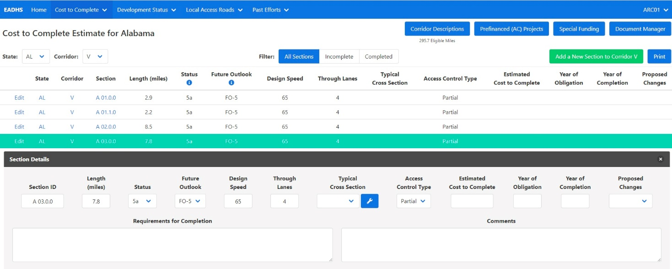
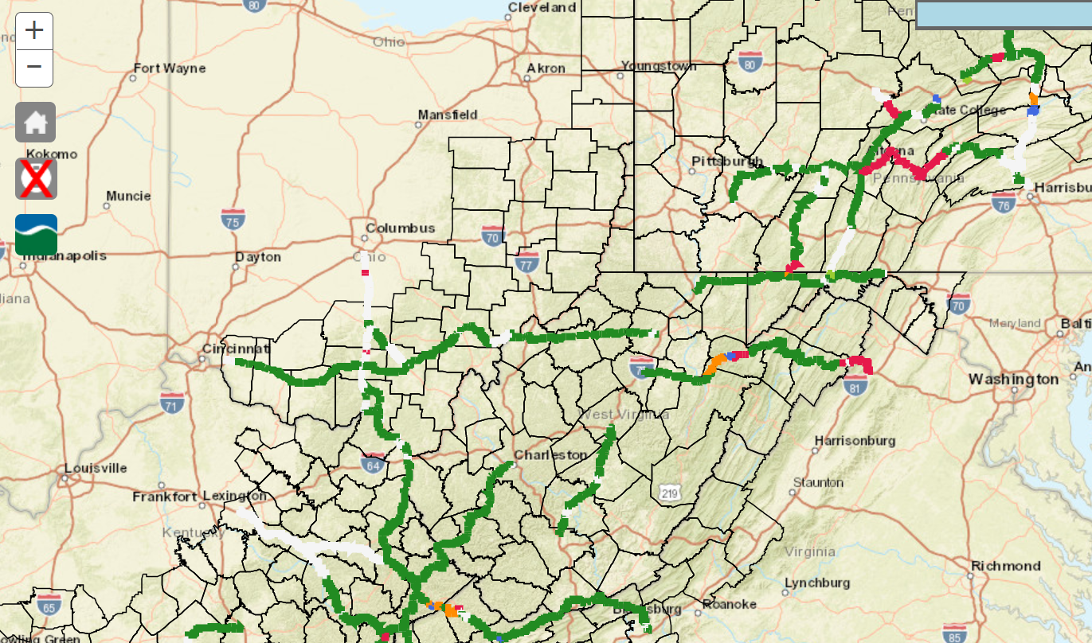
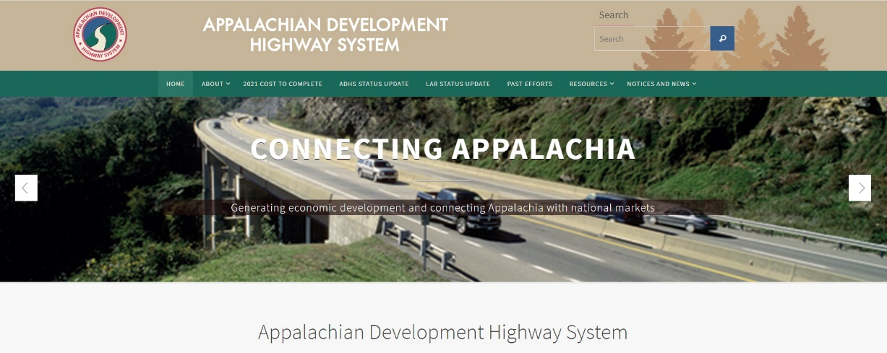
EADHS C2C data input effort is to get each state’s 2021 ADHS cost estimate data into the EADHS C2C platform
*Note: ARC has to be able to reconcile System mileage and be able to track status

Slide 5
Components of EADHS C2C Data Platform
1. ADHS Corridor Description

Slide 6
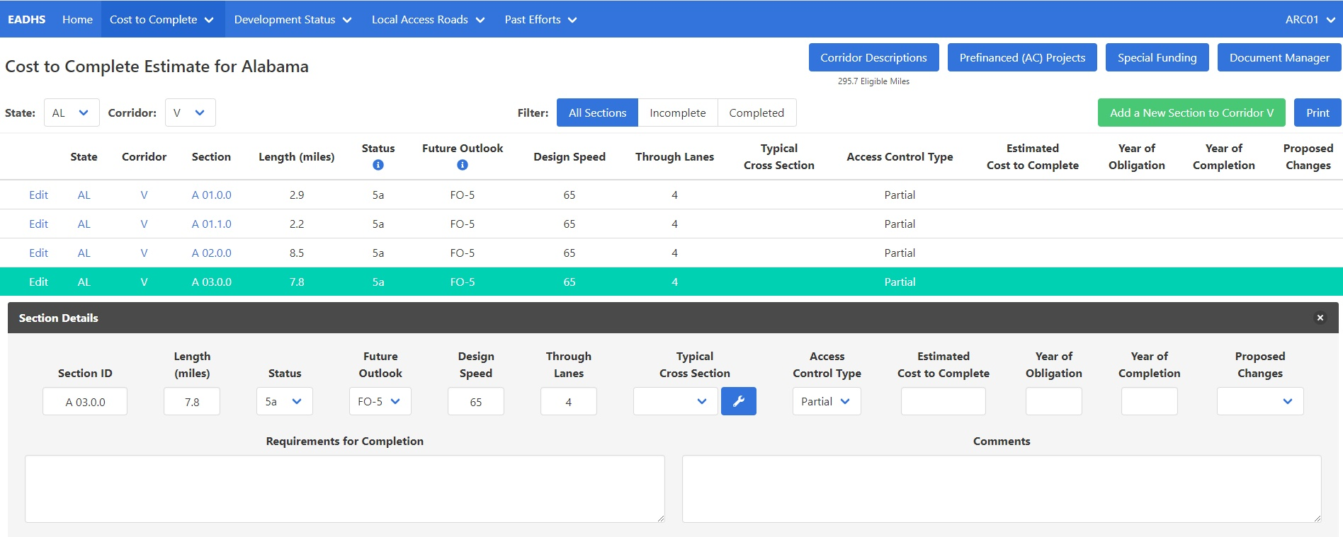
Components of EADHS C2C Data Platform (cont.)
2. C2C Data by ADHS Sections (the building blocks)

Slide 7
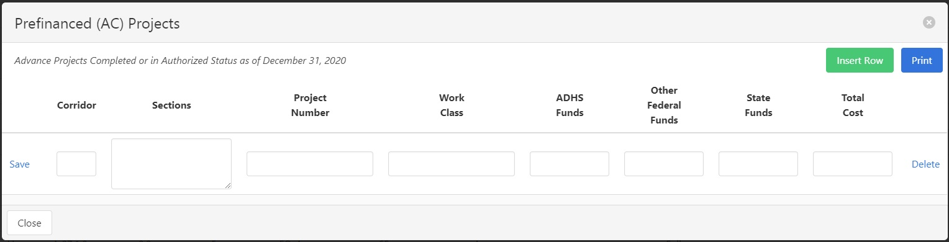
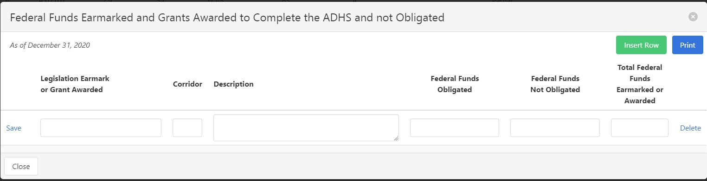
Components of EADHS C2C Data Platform (cont.)
3. Pre-Financed (Advanced Construction) projects
4. Earmark funds or grants going to ADHS

Slide 8

Components of EADHS C2C Data Platform (cont.)
5. EADHS GIS Maps – Individually working with needed states

Slide 9
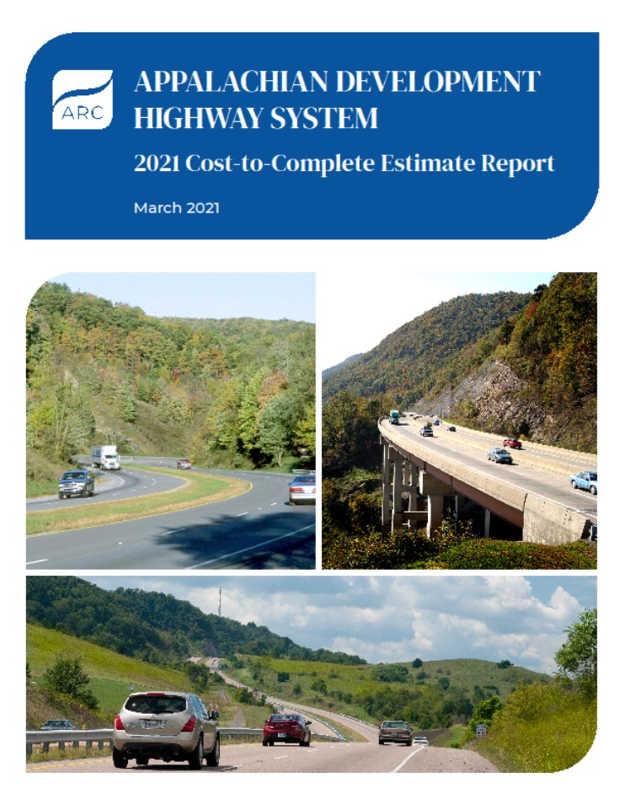
Data are Comparable to the 2021 C2C Report
Status as of 9/30/20
Estimated costs and funds as of 12/31/20
Costs are in 2020 dollars
Pay attention to special cases – undesignated sections/miles
Smart use of NP sections and miles

Slide 10

EADHS Cost to Complete (C2C) Data Input Workshop Overview and Demonstration

Slide 11
EADHS.org Web Portal Resources
2012 Cost to Complete Estimate Guidelines
2007 & 2012 Cost to Complete Estimate Books
2012 Cost to Complete Estimate web application
Tables A, B, C, D, & E
GIS Map
Summary & Utility Reports
2013 Completion Plan web application
Annual Development Status Update web application

Slide 12
Cost to Complete Estimate Goals
Review and validate information for complete and non-participating sections
Update information for incomplete sections
Upload typical cross section diagrams and associate the diagram with each section
Upload relevant documents and associate uploaded documents to state, corridor, or sections
Review and validate corridor descriptions (formerly Table A)
Add information for pre-financed (AC) projects (formerly Table D)
Add information for special funding (formerly Table E)

Slide 13
Corridor Descriptions Data Reference
Corridor
Principal Existing Route Numbers
Description
Eligible Miles
Ineligible Miles

Slide 14
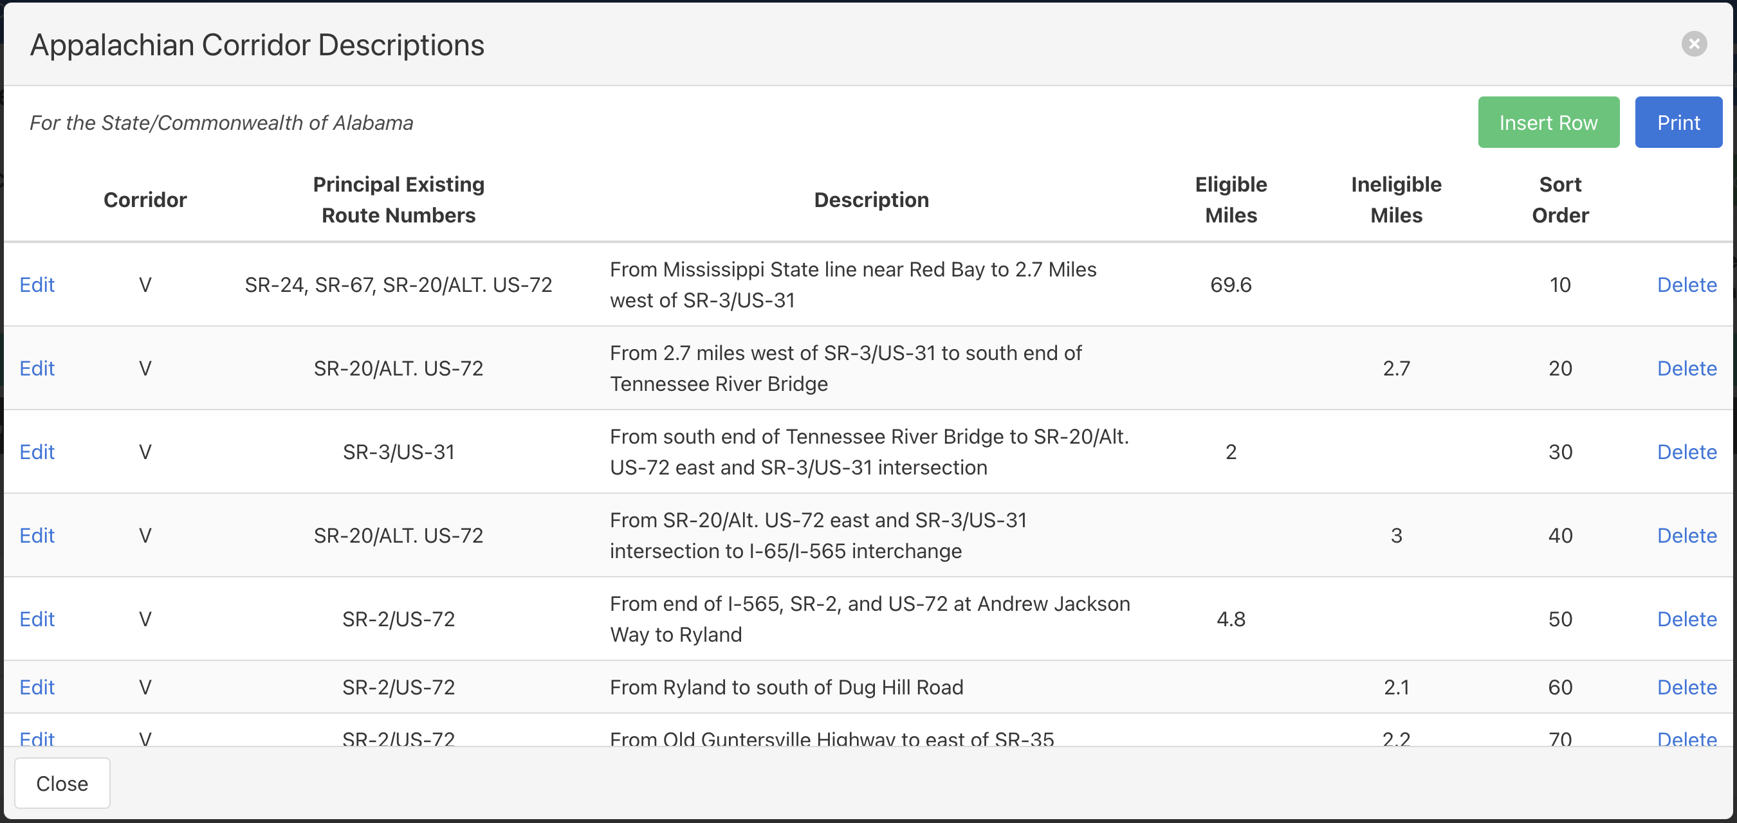
Corridor Descriptions Editor

Slide 15

Corridor Descriptions Data Reference
Corridor
Principal Existing Route Numbers
Description
Eligible Miles
Ineligible Miles
QUESTIONSNS

Slide 16
Cost to Complete Estimate Data Reference
Section ID
Section Length
Status of Development
Future Outlook
Design Speed
Through Lanes
Typical Cross Section
Access Control Type
Estimated Cost to Complete
Year of Completion
Year of Obligation

Slide 17
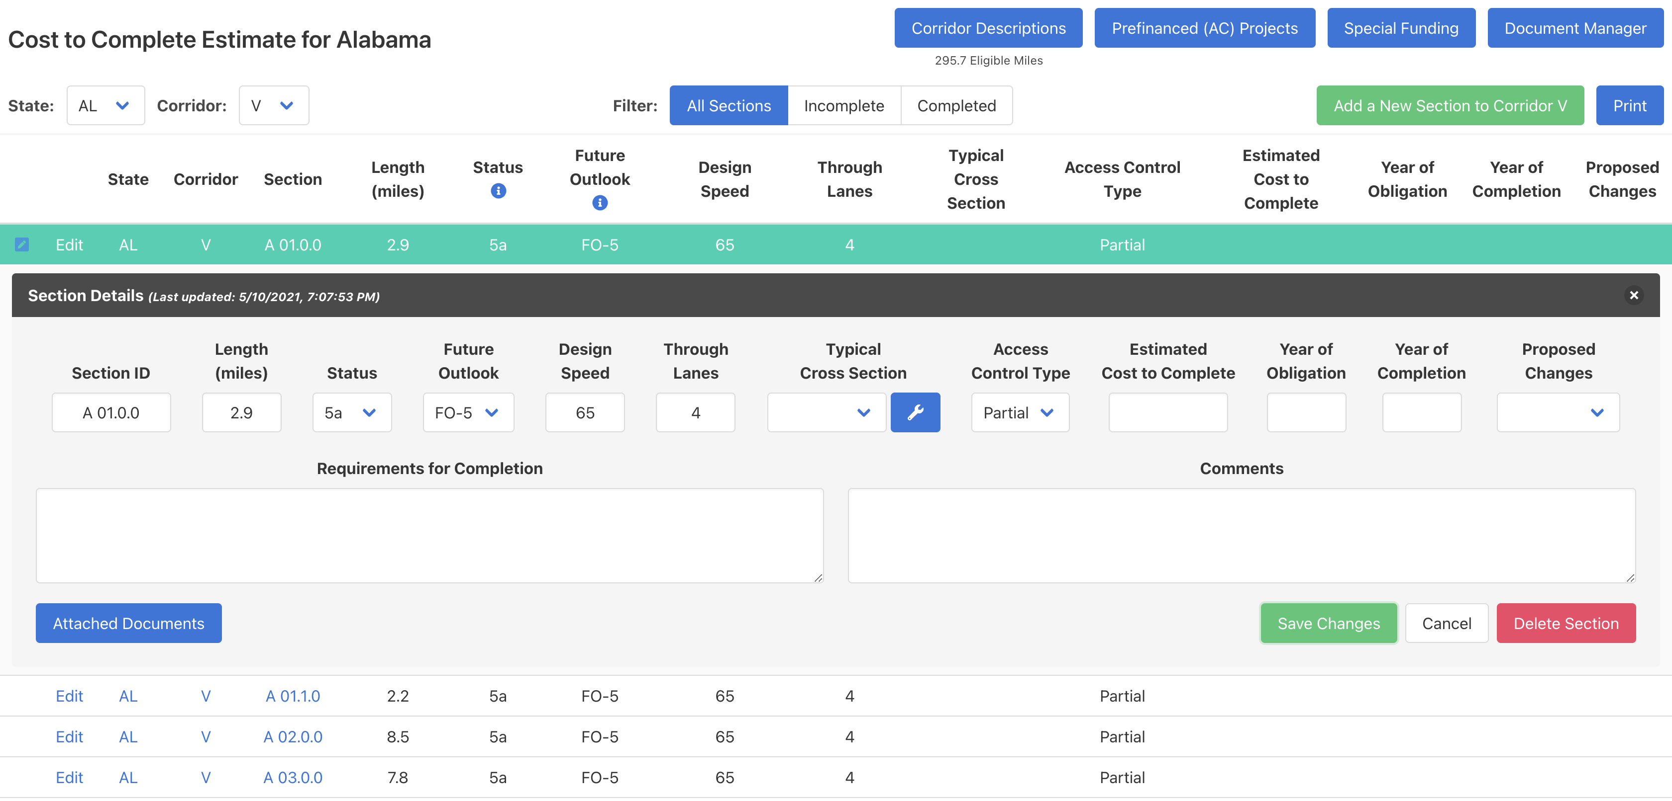
Cost to Complete Estimate Editor

Slide 18
Cost to Complete Estimate Data Reference
Section ID (last updated 2020)
Section Length (last updated 2020)
Status of Development (last updated 2020)
Future Outlook (last updated 2020)
Design Speed (last updated 2012)
Through Lanes (last updated 2012)
Typical Cross Section
Access Control Type (last updated 2012)
Estimated Cost to Complete
Year of Completion
Year of Obligation
QUESTIONSNS

Slide 19
Prefinanced (AC) Projects Data Reference
Corridor
Sections
Project Number
Work Class
ADHS Funds
Other Federal Funds
State Funds
Total Cost

Slide 20
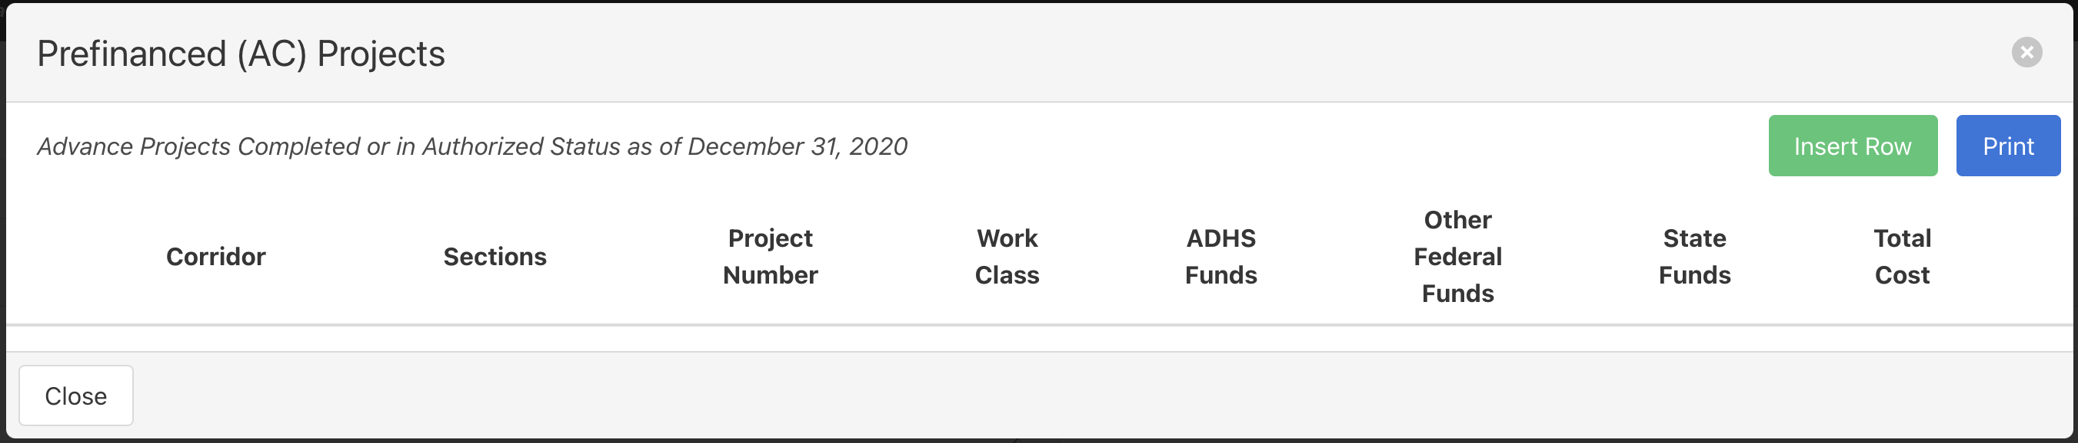
Prefinanced (AC) Projects Editor

Slide 21
Prefinanced (AC) Projects Data Reference
Corridor
Sections
Project Number
Work Class
ADHS Funds
Other Federal Funds
State Funds
Total Cost
QUESTIONSNS

Slide 22
Special Funding Data Reference
Legislation Earmark or Grant Awarded
Corridor
Description
Federal Funds Obligated
Federal Funds Not Obligated
Total Federal Funds Earmarked or Awarded

Slide 23
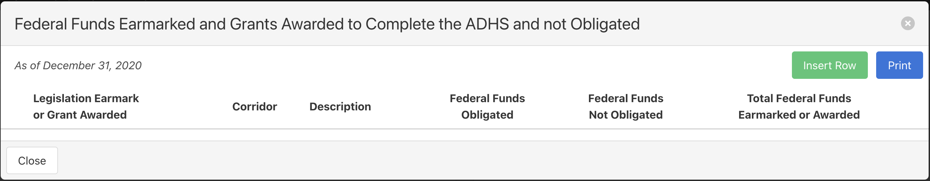
Special Funding Editor

Slide 24
Special Funding Data Reference
Legislation Earmark or Grant Awarded
Corridor
Description
Federal Funds Obligated
Federal Funds Not Obligated
Total Federal Funds Earmarked or Awarded
QUESTIONSNS

Slide 25
EADHS C2C Web Application Demonstration

Slide 26


Questions?
Jason Wang, PE
jwang@arc.gov
(202) 884-7725
Brad Cains
cainsb@muati.org
(304) 696-5745

Slide 27
Next Steps
Expect to complete the data input in a month (June 14, 2021)*;
No need to get executive’s sign-off but FHWA Division to confirm and verify the result and notify ARC/FHWA HQ for the completion of the effort;
Tech support will be provided by ATI during business hours and feel free to contact ATI/ARC for questions or, if needed, asking for a virtual meeting;
ATI team will work with individual states who need to update GIS data or develop new GIS maps;
ARC will review the completed data input results and provide feed back and/or asking for certain revisions, if needed.
* States with scope approval requirements or major changes are not subject to this deadline. Updated or new GIS maps are not included in this delivery schedule.

